Slide 1
Team 10 Visualization
Ashish Shinde (NUID: 002199940)
Disha Vaswani (NUID: 002199940)

Slide 2
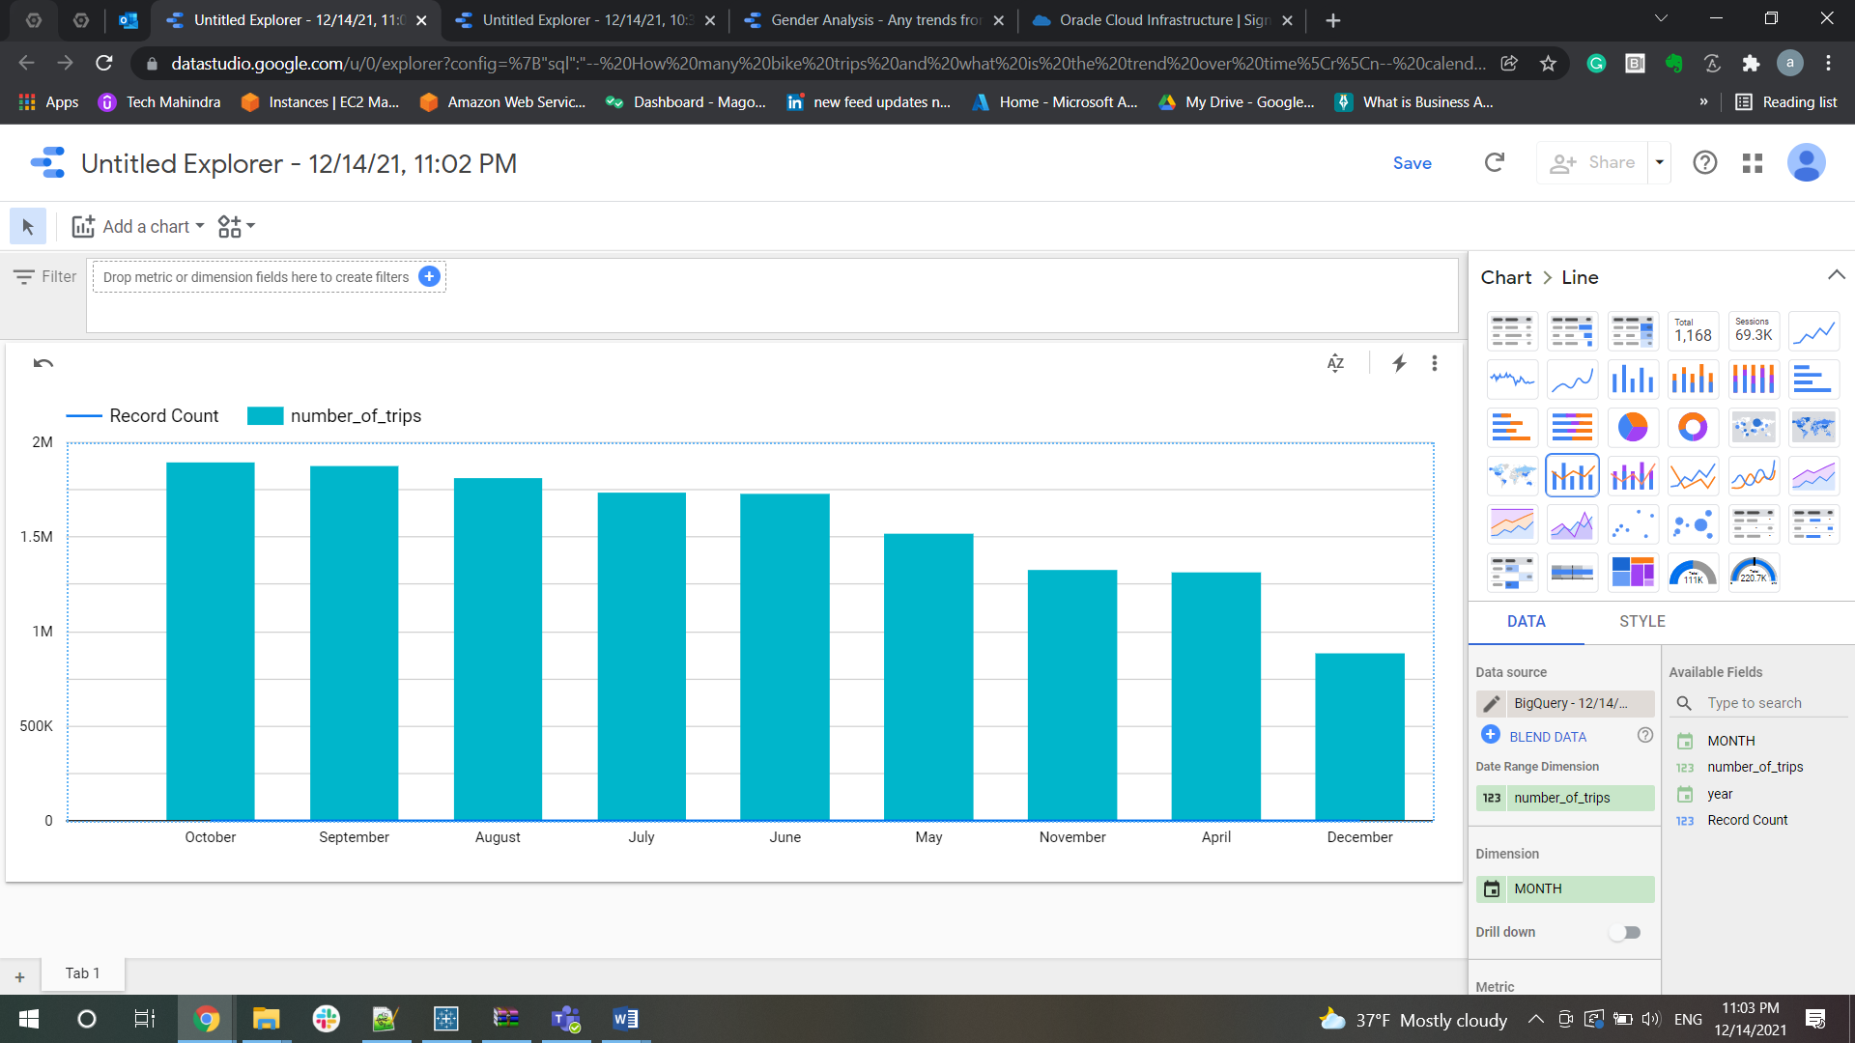
As per analysis, for year 2017 maximum trips were in the month of October

Slide 3
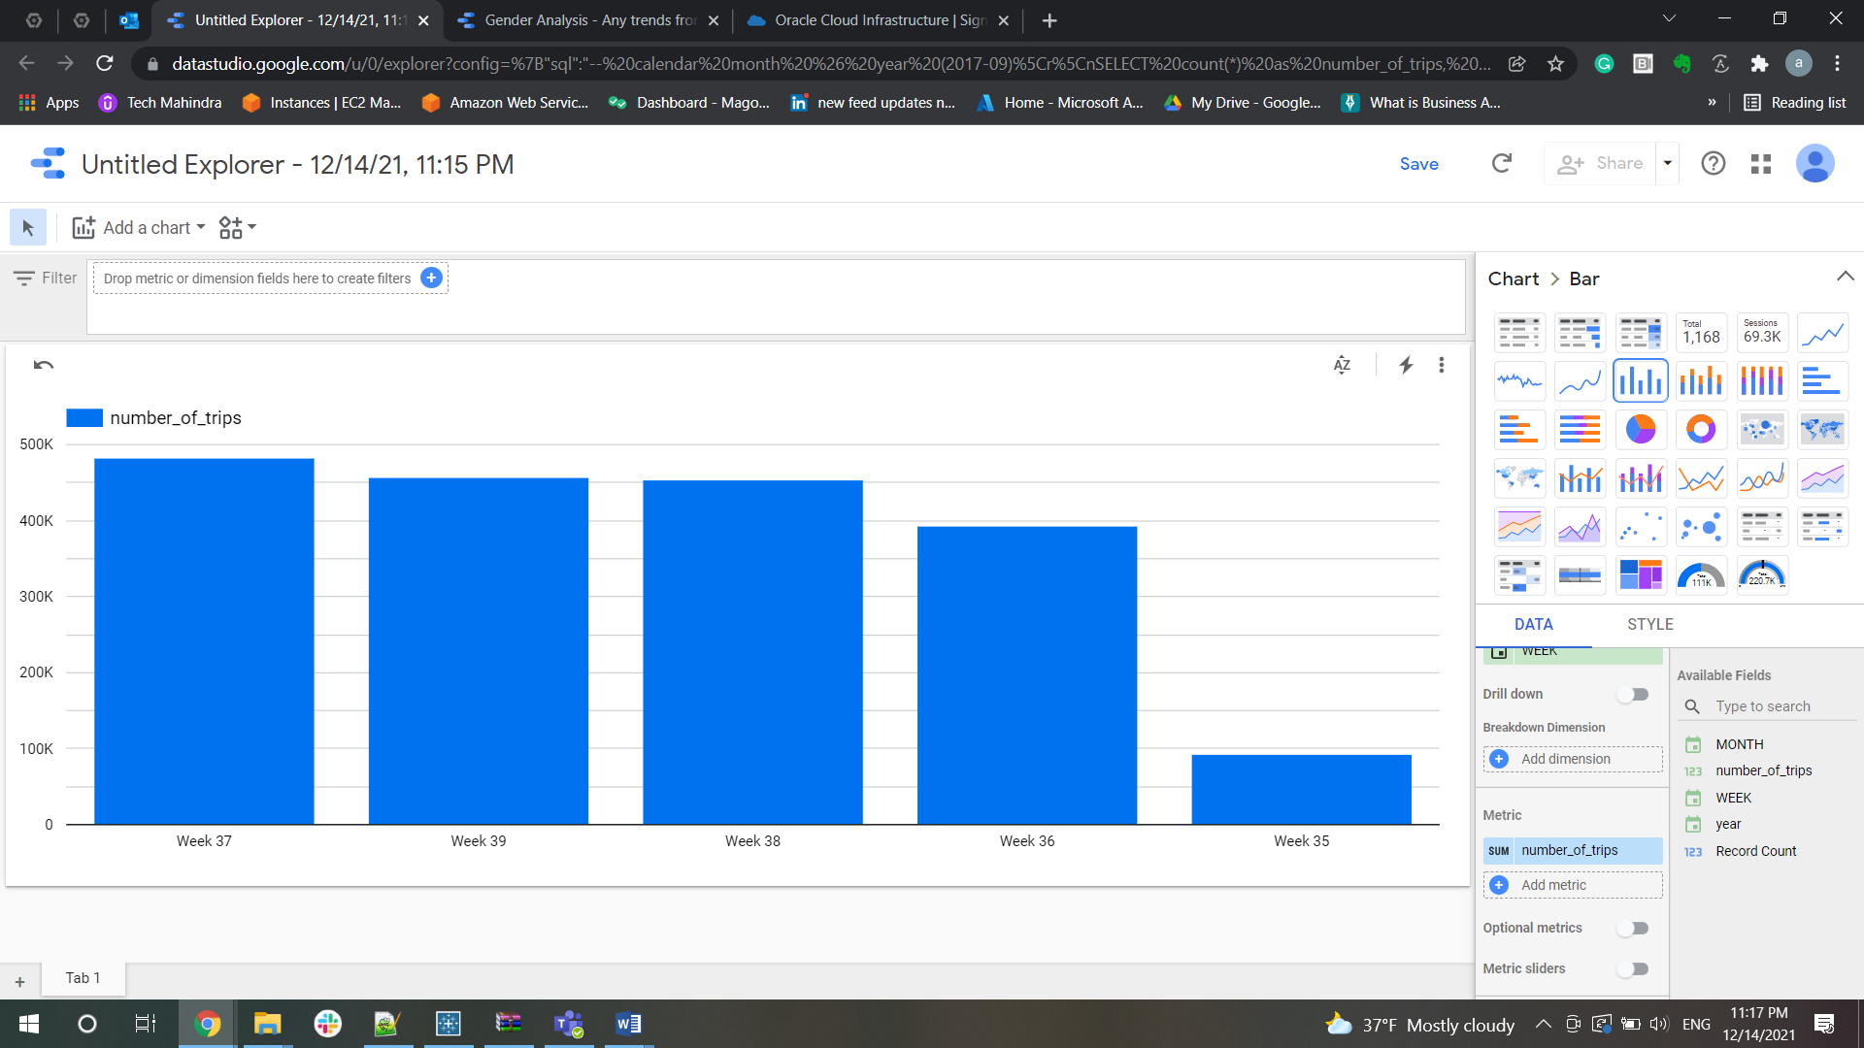
As per analysis, for year 2017 and month 09 (September) maximum trips were in the week 37

Slide 4
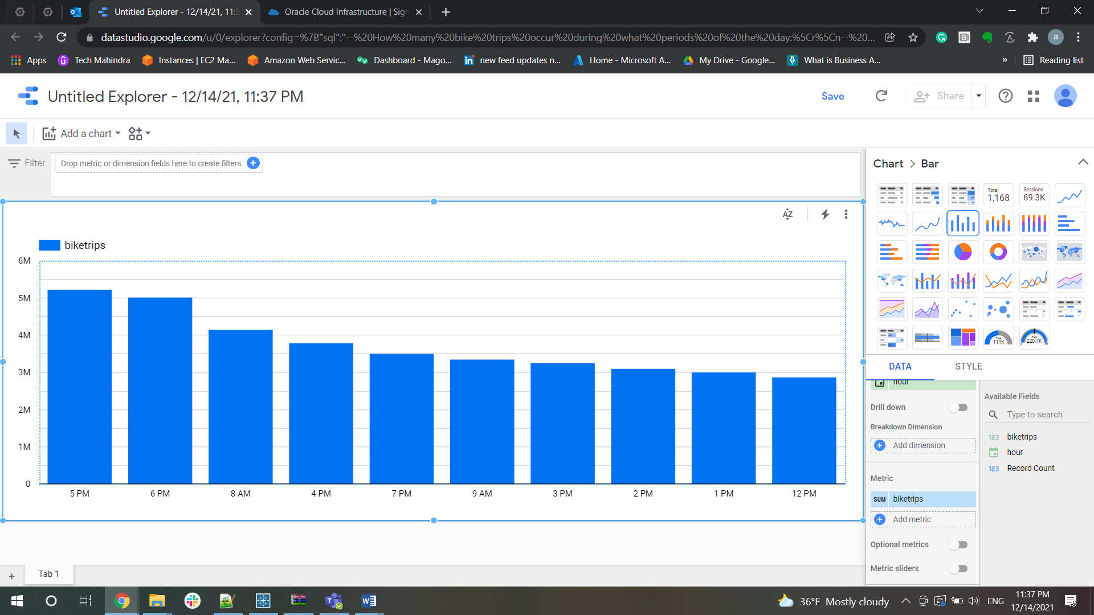
As per analysis, Maximum trips occurred on 5 PM of the day

Slide 5
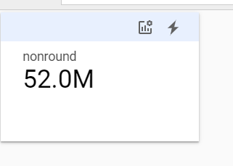
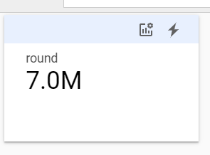
Round trip & Non-round trip users

Slide 6
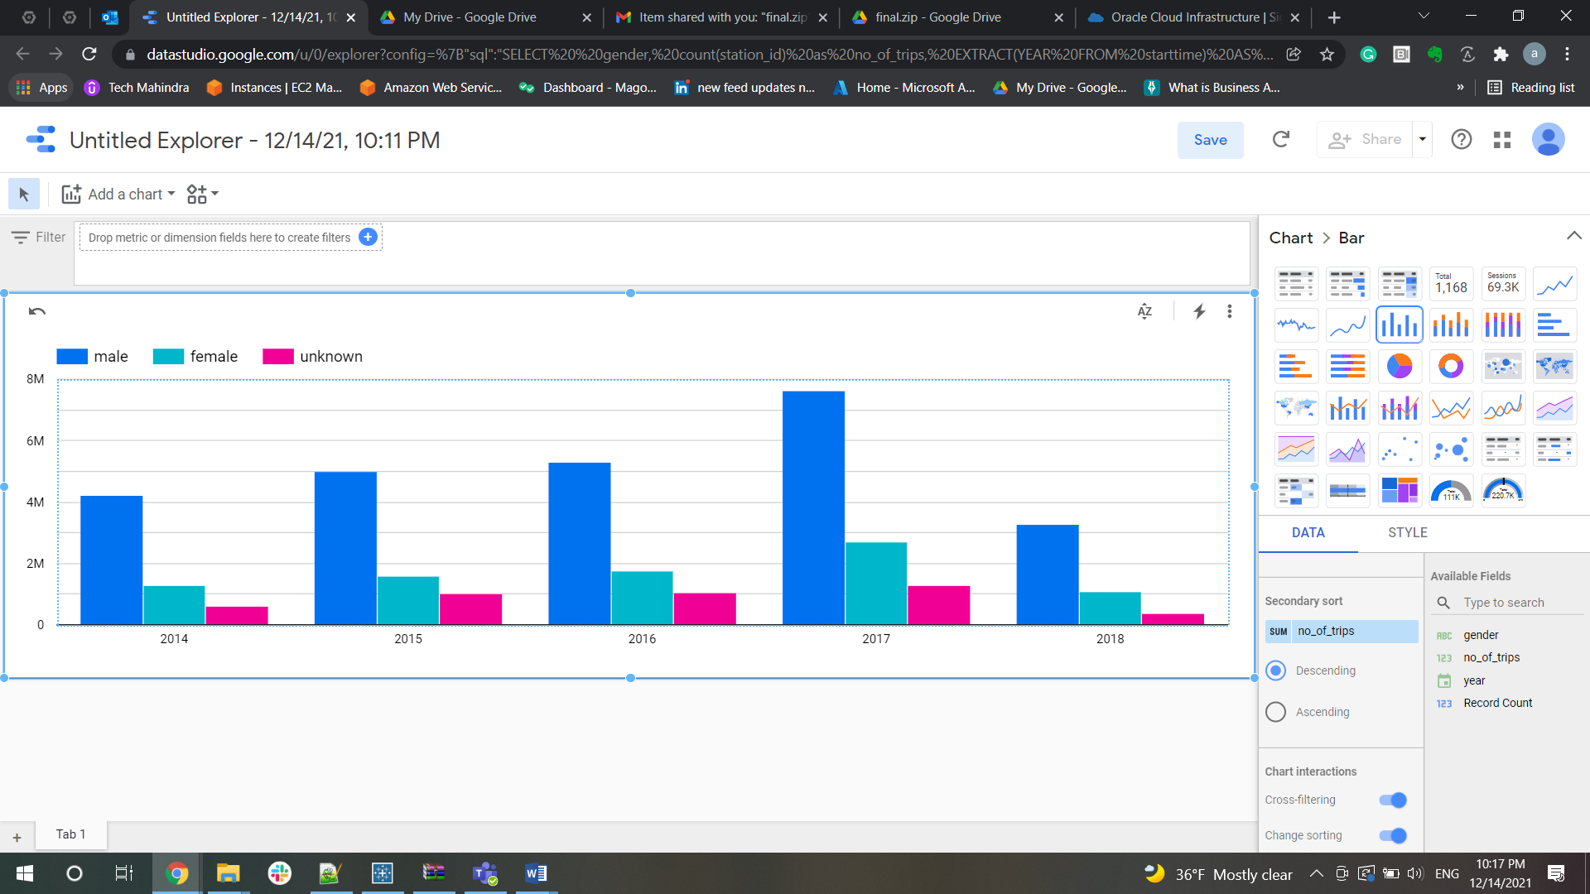
Citi bikes have more male users than female users

Slide 7
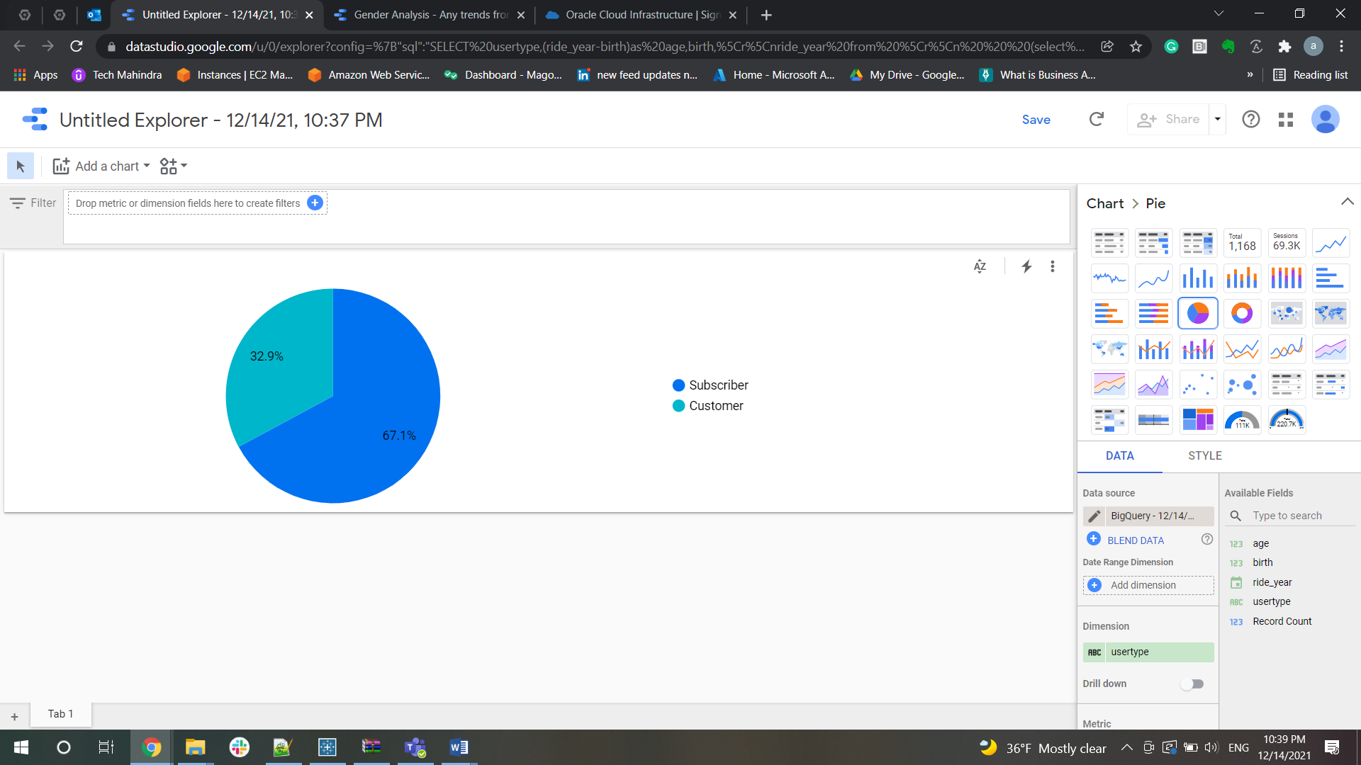
Number of Subscribers are more than the customers

